Slide 1

Black Rifle Coffee Company - B2B Trade Show Strategy
Outdoor Retailer Summer Market 2025
SASAN AHOVAN

Slide 2

Objectives
- Reconnect with specialty retail and hospitality partners
- Re-establish BRCC as a high-margin, specialty coffee brand
- Drive B2B orders through strategic messaging and booth engagement

Slide 3

Target Audience
- Boutique Lodges and Campgrounds
- Independent Outdoor Retailers
- Specialty Coffee Shops
Buyer Persona:
- Values American-made, mission-driven products
- Seeks premium, small-batch goods
- Wants products with strong customer loyalty

Slide 4
Campaign Theme 1
Theme: Brew Bold. Build Loyalty.
Focus: High margins, strong brand loyalty, premium quality
Tagline: Patriot-grade profit margins. Repeat customers. Bold flavor.

Slide 5
Campaign Theme 2
Theme: Small Batch. Big Mission.
Focus: Veteran-owned, community-driven, values-based partnerships
Tagline: Built with grit. Roasted with purpose. Partner with meaning.

Slide 6
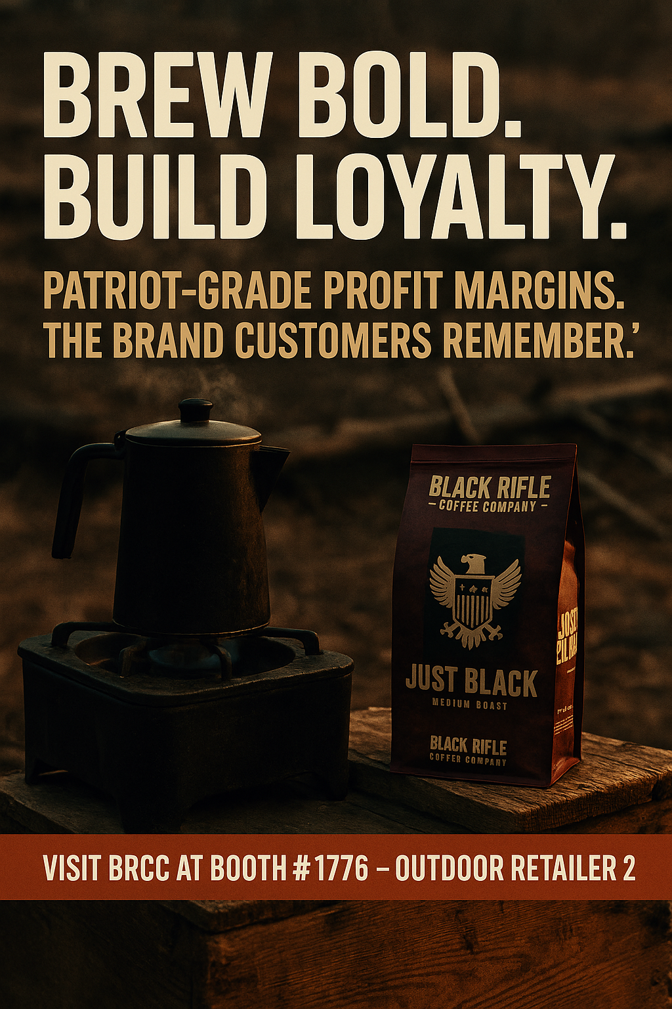
X Posts (Twitter)
Theme 1:
"Profit that salutes your bottom line. Loyal customers. Patriotic brand power. Brew bold. Booth #1776."

Slide 7
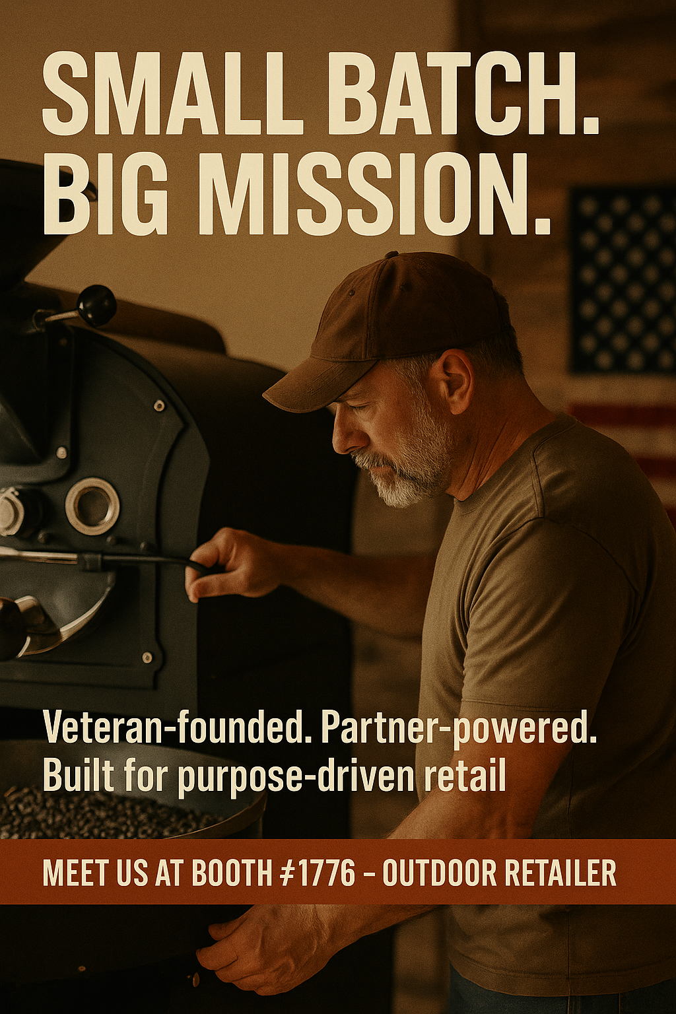
X Posts (Twitter)
Theme 2:
"American-sourced, veteran-roasted. Ready for retailers who care where their coffee comes from. Booth #1776. #BigMissionCoffee"

Slide 8
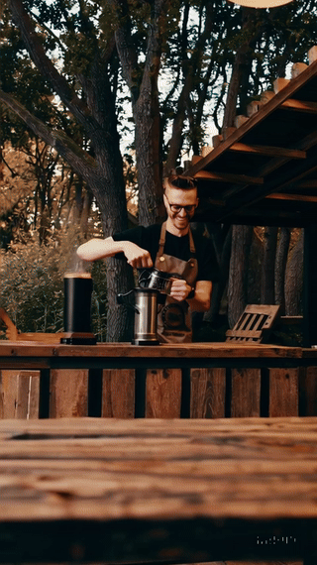
TikTok Video Concepts
Theme 1 - POV Trend:
Barista makes BRCC coffee → happy repeat customer → high-five with store clerk
CTA: "Want loyal foot traffic? Let’s brew success. Booth #1776."

Slide 9
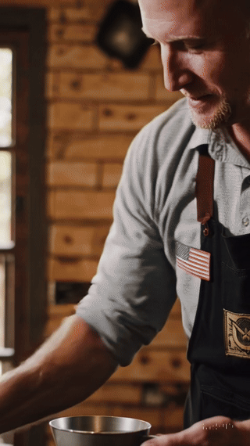
TikTok Video Concepts
Theme 2 - Mission Focus:
Veteran roasting → boutique lodge serving BRCC → partner handshake
CTA: "Meet the team. Taste the mission. Booth #1776."

Slide 10
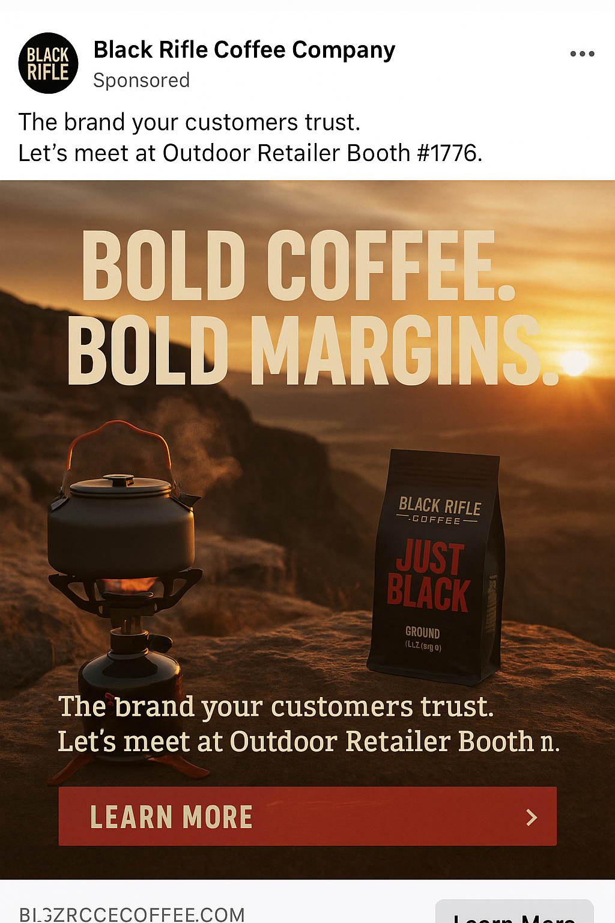
Facebook Boosted Posts
Theme 1:
Visual: Camp stove brewing BRCC on a cliff edge
Text: "Bold coffee. Bold margins. Let’s meet at Booth #1776."

Slide 11
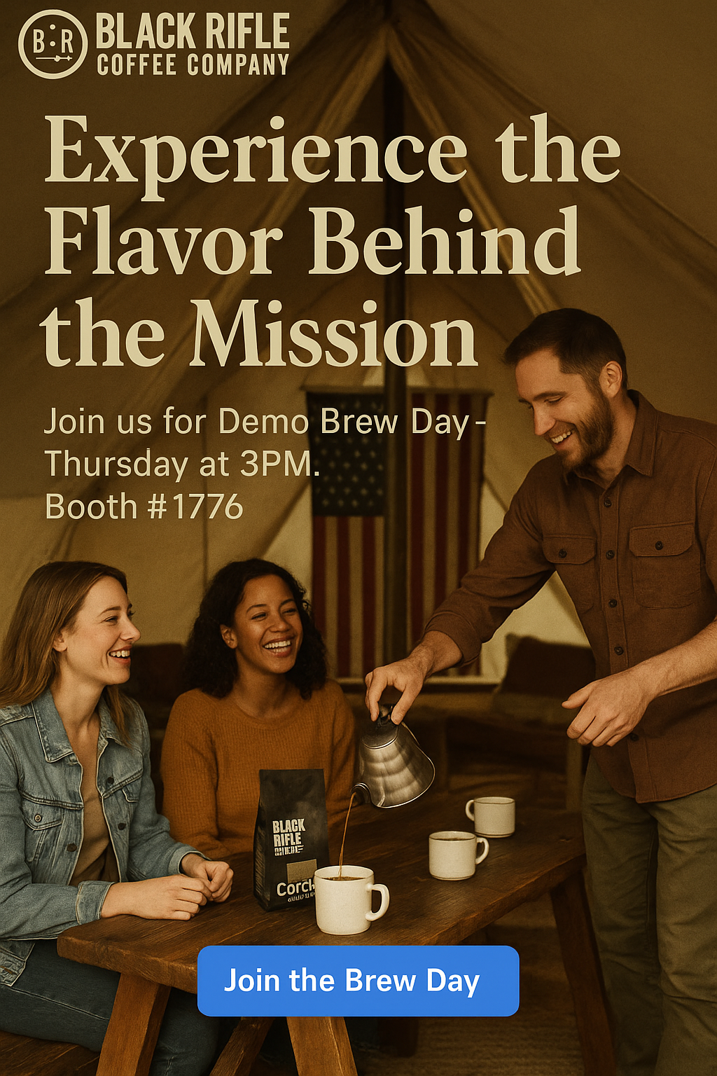
Facebook Boosted Posts
Theme 2:
Visual: Hospitality-style tasting at a glamping tent
Text: "Demo Brew Day. Sip. Connect. Partner. Thursday 3PM near Booth #1776."

Slide 12
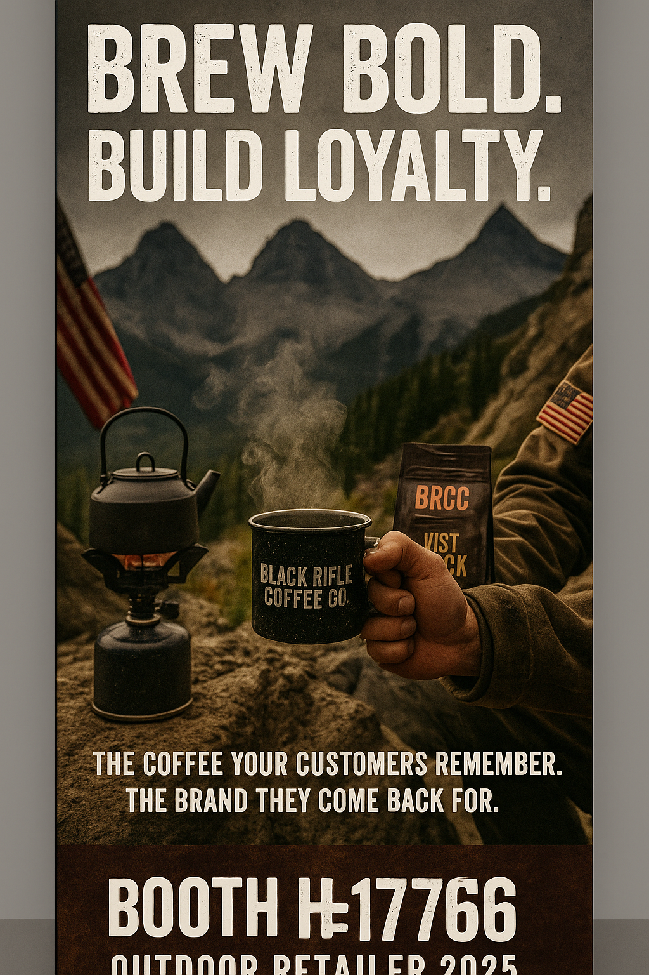
Trade Show Banners
Banner 1 (Theme 1):
Headline: "Brew Bold. Build Loyalty."
Subhead: "The coffee your customers remember. The brand they come back for."

Slide 13
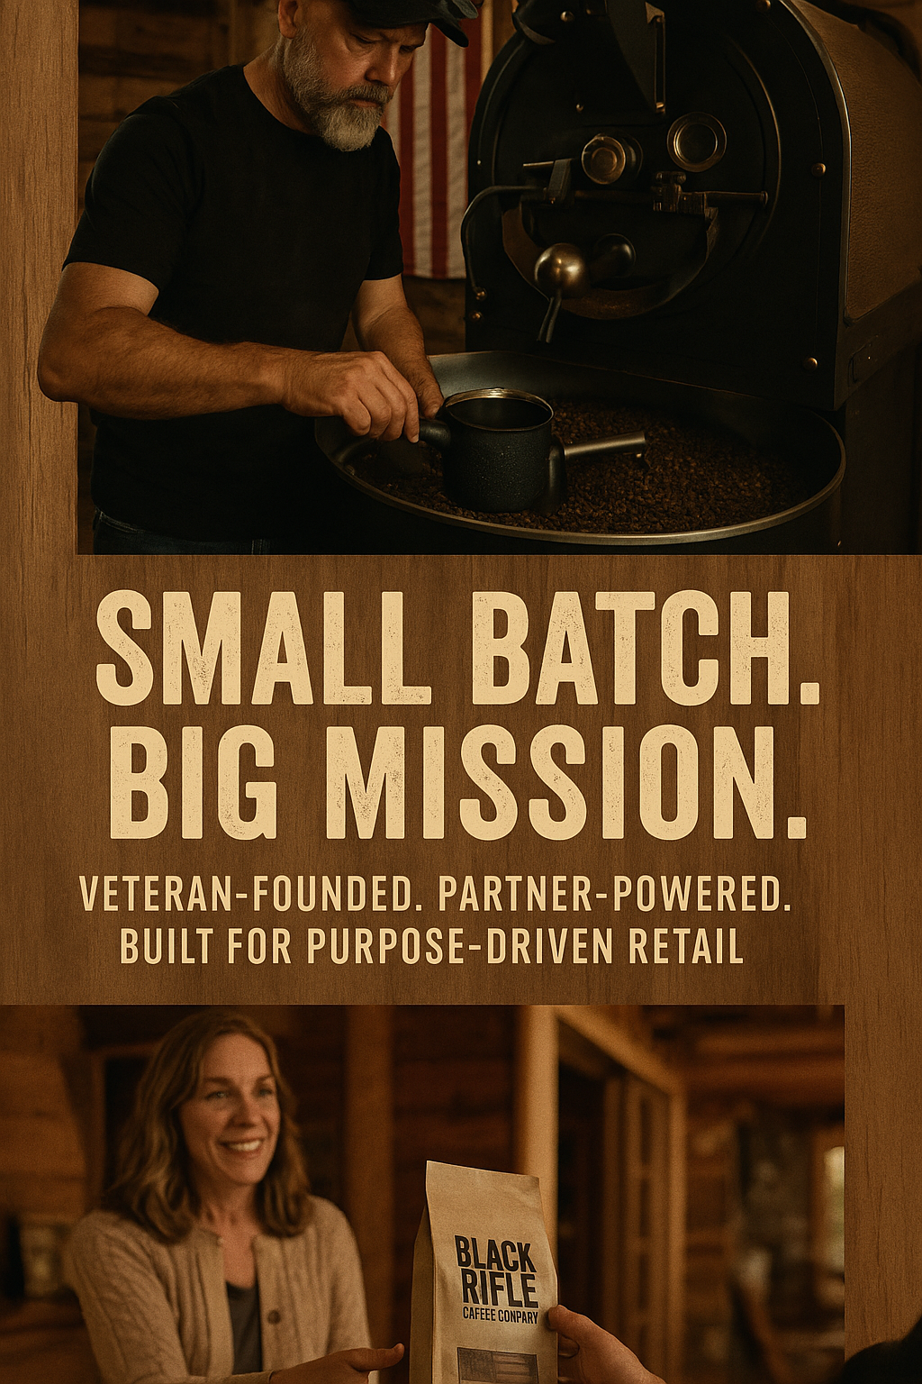
Trade Show Banners
Banner 2 (Theme 2):
Headline: "Small Batch. Big Mission."
Subhead: "Veteran-founded. Partner-powered. Built for purpose-driven retail."

Slide 14
Sales Rep Introductions
Known Retailers:
1. "Hey SASAN great to see you again! We've got bold new brews your customers will crave."
2. "Stopped by Bass Pro recently? Ours comes with better margins and loyal buyers."
New Prospects:
1. "Hi there—do your customers ask for coffee by name? Ours do. Let me show you why."
2. "Looking to upgrade your coffee section with meaning and margin? We've got you covered."

Slide 15
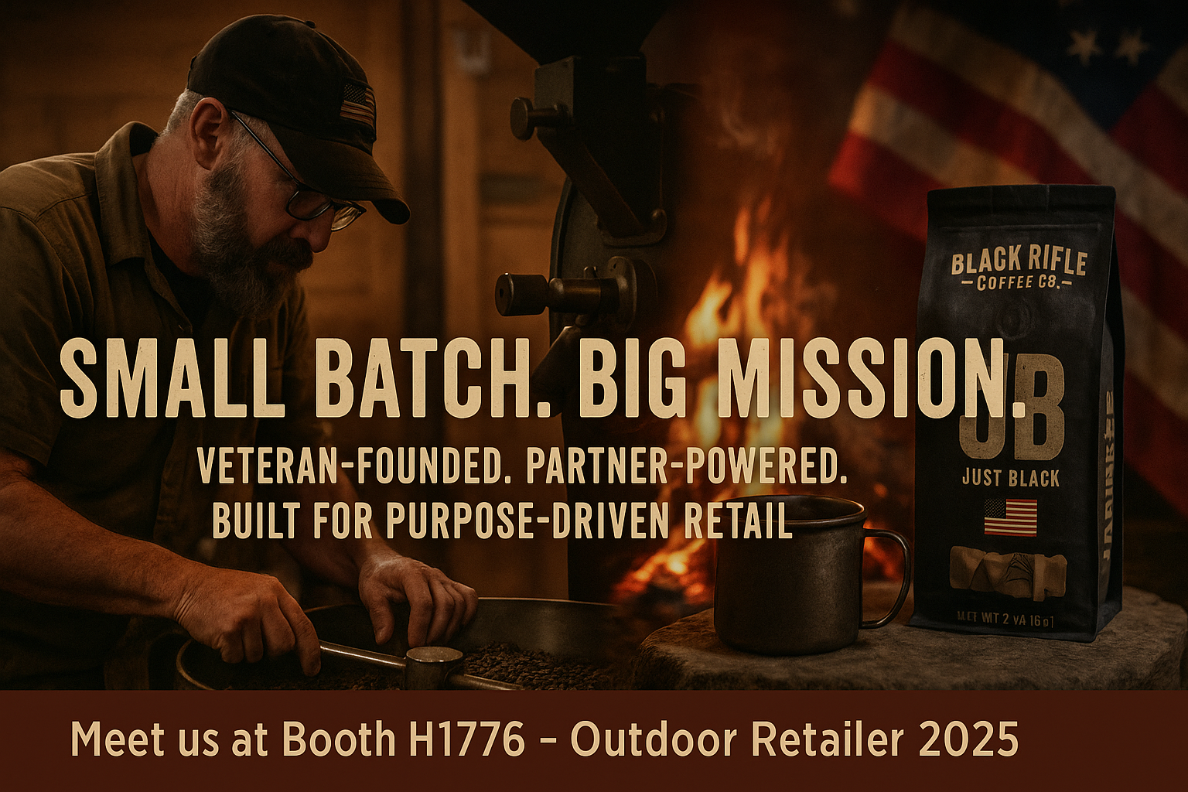
Trade Show Loop Video (20-sec script)
Visuals:
- Veteran roasting beans
- Campfire coffee brewing
- BRCC packaging with flag
- Lodge owner receiving product
Voiceover:
"This isn’t just coffee. It’s a commitment. Roasted in small batches. Backed by service and story. Black Rifle Coffee: Built for bold partners."

Slide 16
Internal Testing Summary
Poll Results (5 people):
- 3 preferred "Small Batch. Big Mission" (felt more trustworthy)
- 4 said they'd stop at booth for the demo day event
- Visuals with veteran and lodge owners were most memorable
Recommendation: Anchor campaign with Theme 2: Small Batch. Big Mission for deeper emotional impact.

Slide 17
Closing Strategy & Notes
- Focus booth design on authenticity, mission, and small-batch values
- Use demo events and storytelling visuals
- Equip reps with tailored intros and high-impact content
- Aligns with BRCC’s roots while elevating partner appeal

